Slide 1
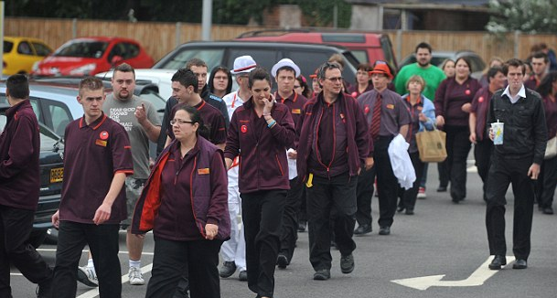
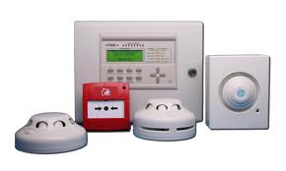
Amendments to UWFS Policy
Ian Kay Station Manager Protection

Slide 2
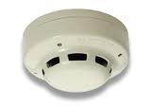
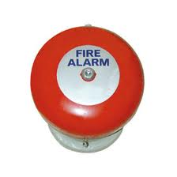
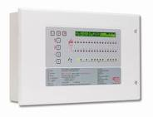
Some definitions
Automatic fire detection (AFD)
Automatic fire alarm (AFA)
False alarm…or ‘unwanted fire signal’ in fire and rescue service speak

Slide 3
Impact of responding to false alarms
Disruption to business/operations, safety risk to evacuees, complacency
Environmental issues caused by increased appliance movements
Fire crews are not available to respond to genuine life threatening emergencies
Risk to crews and other road users in responding under ‘blue light’ conditions
Financial costs of pay, fuel, administration
Disruption to prevention work
Disruption to on-call firefighters’ primary employment
Disruption to firefighter training and community safety work

Slide 4
Background
2007 - Service’s original UwFS policy was introduced
2012 - major review of the UwFS policy:
introduced call challenge procedure
changed the PDA to AFA’s
enhanced advice given in response to single UwFS’s
implemented more robust ways of managing the Service’s relationship with the parties responsible for premises with unacceptably high levels of AFA’s
2014 – A further incremental change to UwFS policy is made.
2017 – A further incremental change to UwFS policy is made.

Slide 5
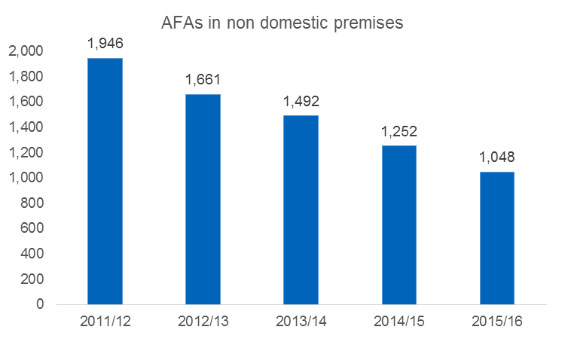
However…
“We reviewed the policy and consider proposals to reduce numbers further.”
23% reduction since 2014
46% reduction since 2011 – 2.4 fewer incidents a day
2015/16 – 1048 AFA’s attended

Slide 6
Policy
Non-attendance at all non-sleeping risk non-domestic premises 24/7

Slide 7
Impact of Policy
 | Likely reduction in AFA’s (% based on 2015/15 figures) | Financial implications | Public Safety & Environmental implications
 | 66.8% | estimated non-cashable savings of £844,200 reduced fuel costs | 700 less calls per annum decrease in emissions/reduced carbon footprint crews available to attend other ‘real’ emergencies, training and community safety activities. reduced risk of ‘blue-lights’ / high-speed vehicles being involved in road accidents
send one fire engine with some temporary exemptions

