Slide 1



Notes:
Before you continue, share the story of Robin 2 the Rescue and use the slides that follow to explore what you’ve learnt together from Robin’s adventure.
Watch the animated story or download the ebook at cheshirefire.gov.uk/robin

Slide 2
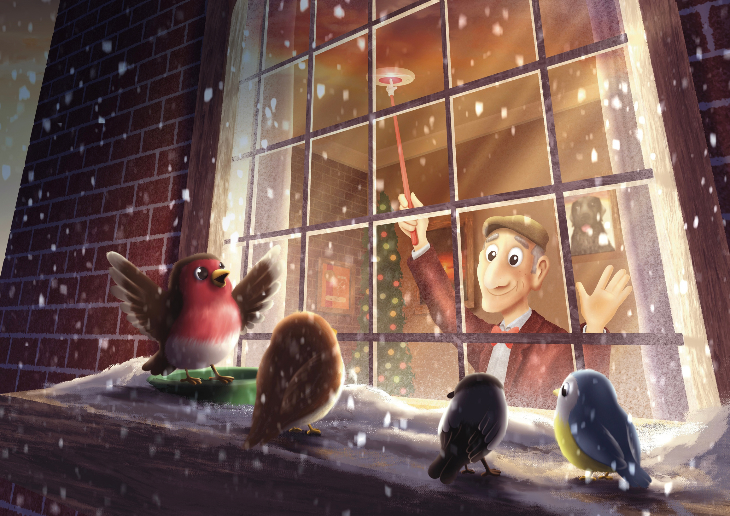
Notes:
Questions to ask
Does anyone know if they have smoke alarms at home?
Has a grown-up ever pressed the button to test one?
What sound does a smoke alarm make?
Why do you think smoke alarms are important?
How often do you think a smoke alarm should be tested?
Key message
Robin says: "Test your smoke alarms weekly, don’t hang about!“
Smoke alarms give us an early warning if there is a fire in the home. Encourage children to ask a grown-up to test their smoke alarms regularly.
Test it Tuesday is a good way to remember and build a safety habit in the home.

Slide 3
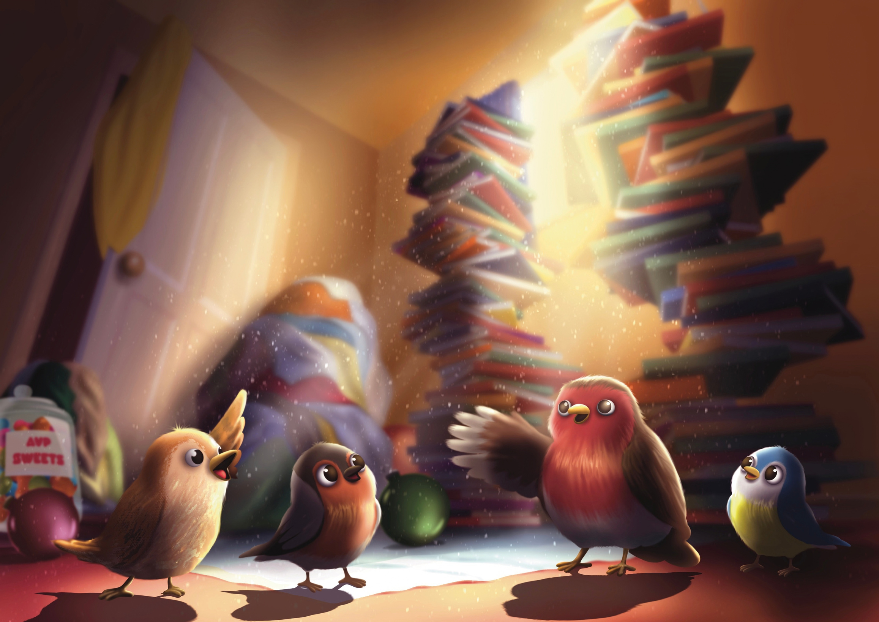
Notes:
Questions to ask
What is wrong with the bedroom Robin visits?
Can you spot anything that might be in the way?
What might happen if you had to leave the room quickly and there were toys, clothes or books on the floor?
Why is it important to have a clear path to the door?
Key message
Robin says: "Keep escape routes clear, so you can get out!“
If there is a fire and the smoke alarm sounds, messy floors could slow you down or cause you to trip when trying to get outside safely.

Slide 4
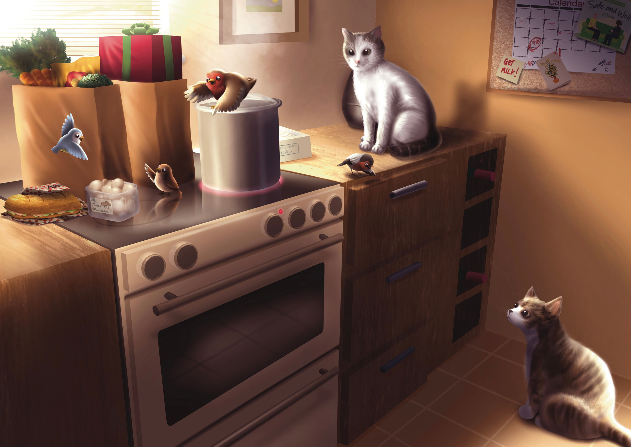
Notes:
Questions to ask
What did Robin and his cadets find in the kitchen?
What might happen if things are left on a hot hob?
Does anyone put drawings, toys or other items on their kitchen worktop?
Could these things get too close to a hot cooking area?
Who has a dog or cat at home?
Did you know pets can sometimes jump onto worktops or accidentally press hob controls?
Key message
Robin says: "Keep your hobs clear, don’t leave things out!“
Never leave bags, shopping, paper, tea towels, toys or other items on or near a hob. Even when cooking has finished, hobs can stay hot for some time.

Slide 5
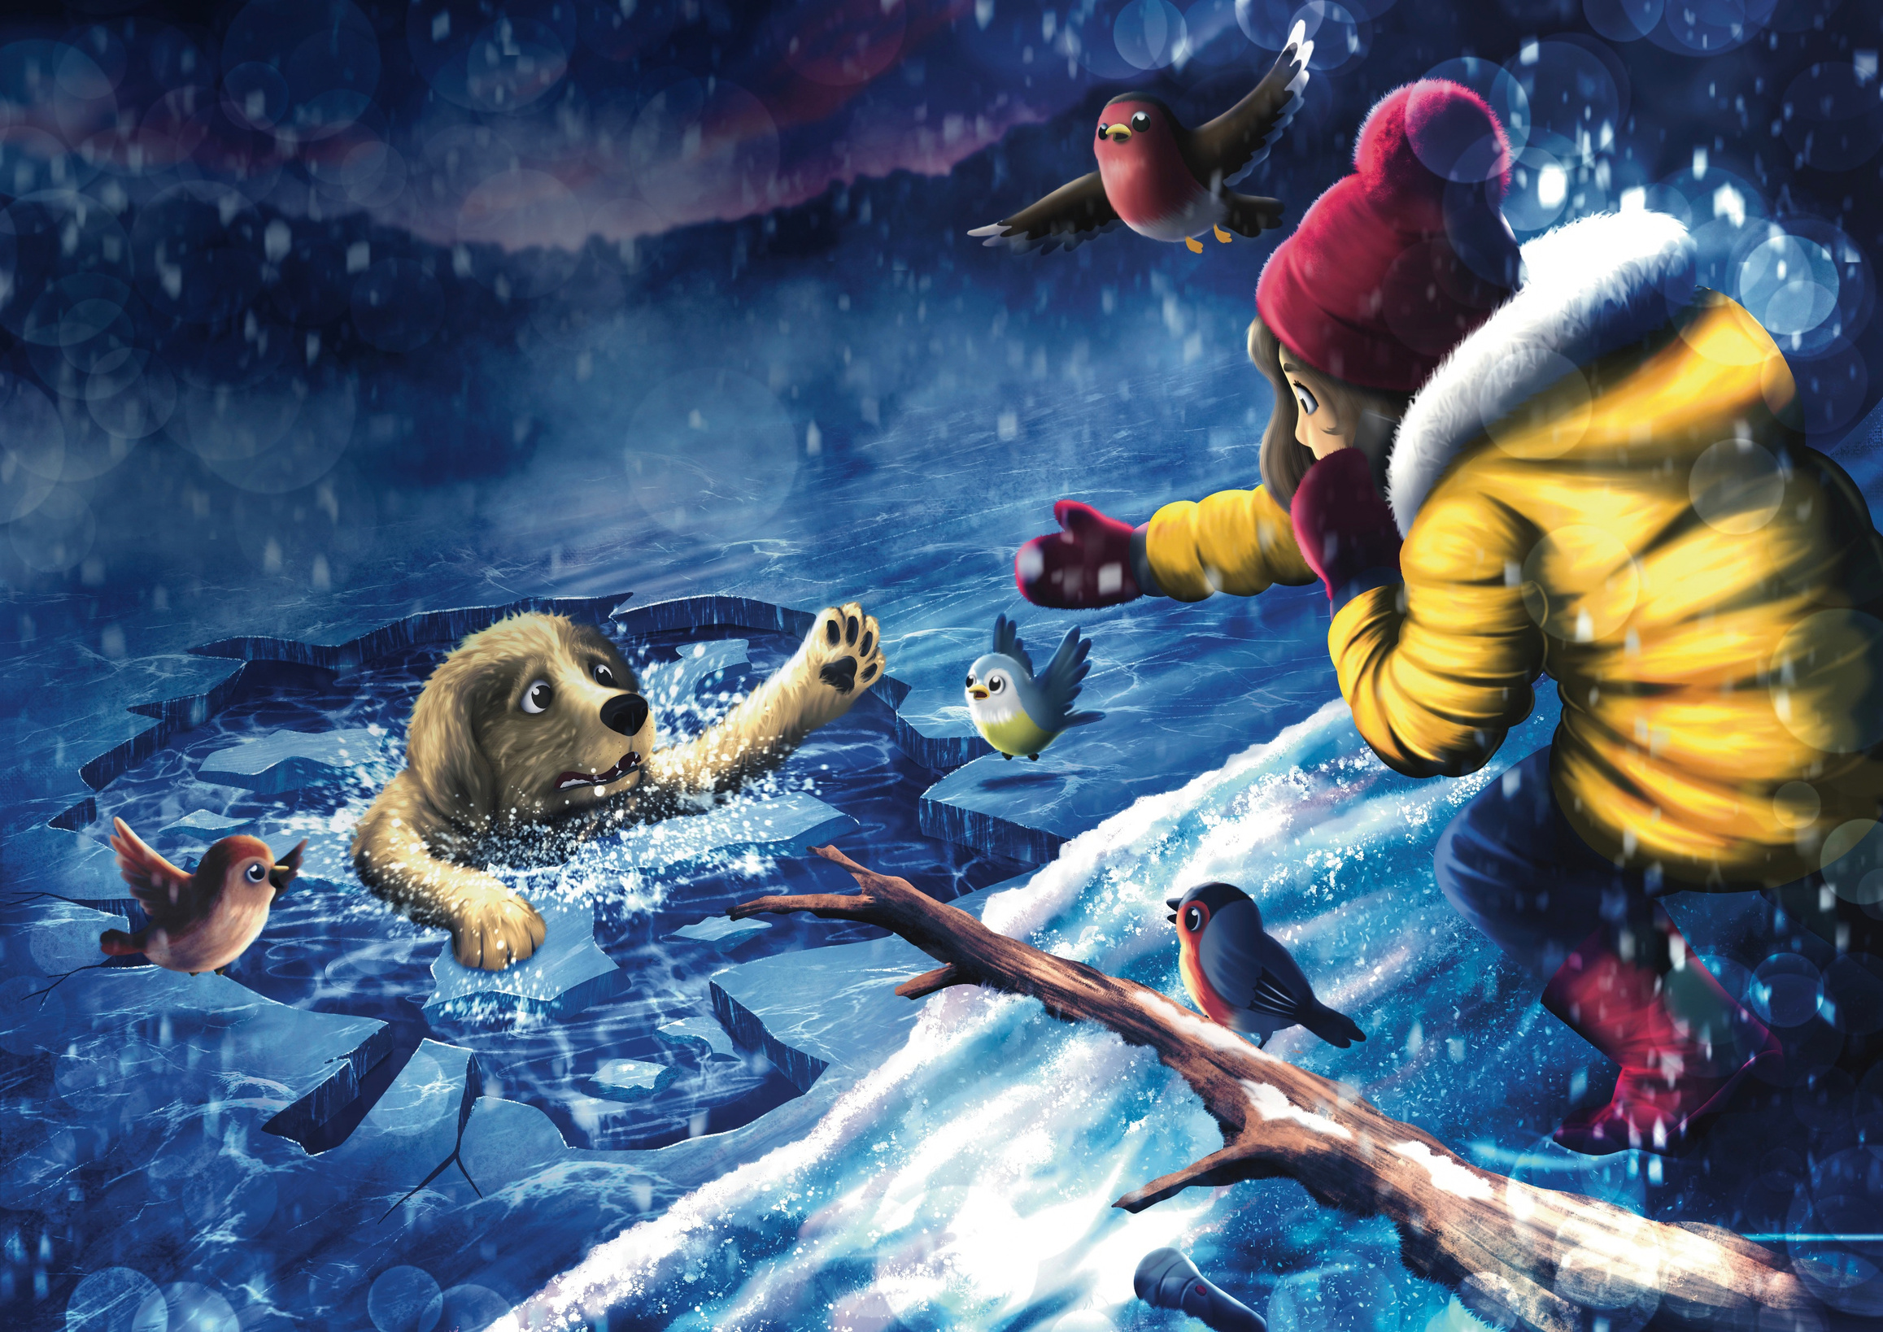
Notes:
Questions to ask
Why was Old Dog in danger?
Why is icy water so dangerous?
What did Robin and the cadets do to help?
Explain that cold water can quickly make it difficult for someone to move, swim or help themselves. This is why it is important to get help quickly while keeping yourself safe by not going in the water.
The Water Safety Rules
Teach children to remember:
SHOUT - Call loudly for help and attract the attention of nearby adults.
REACH - Use something long, such as a stick or branch, to help the person without getting too close to the water yourself.
THROW - Throw something that floats, such as a life ring, throw line, football or another floating object, to help them stay afloat.
DON'T GO - Never enter the water or go onto the ice yourself. You could quickly become another person needing rescue.
CALL 999 - Call for the emergency services. If you do not have a phone, get help from an adult immediately.
FLOAT TO LIVE - If you are in danger, lie on your back with your ears in the water and steady your breathing until help arrives or you can reach safety.
Key message
Robin says: "Help others safely. Never put yourself in danger.“
Firefighters receive specialist training and wear protective gear to carry out rescues safely - always call 999 if someone needs rescuing from water.

Slide 6
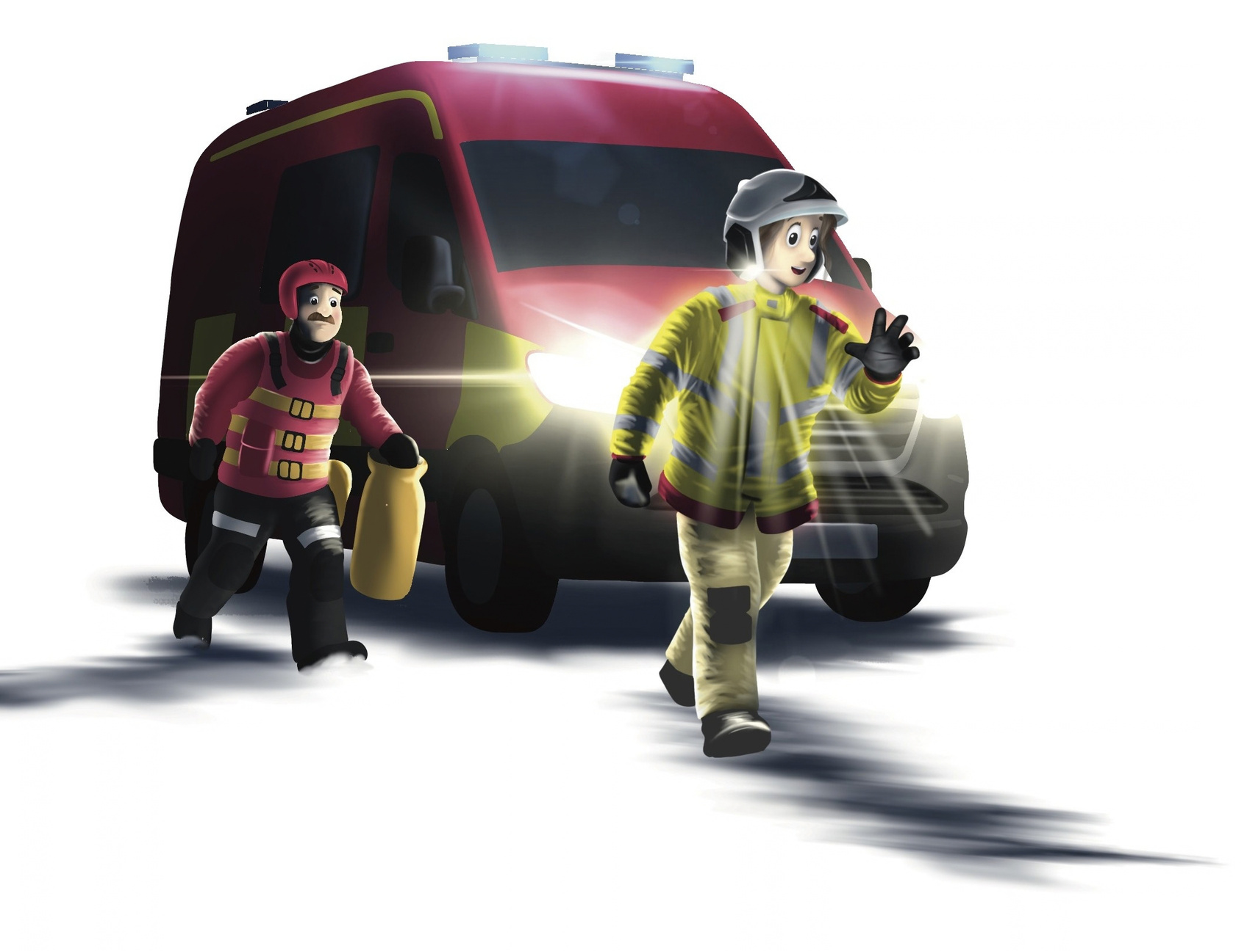
What does a firefighter do?
Notes:
Firefighters help people, animals and communities stay safe. They do lots of different jobs, including:
Putting out fires in homes, cars and outdoors using hoses and special equipment.
Helping people after car accidents and rescuing them safely.
Rescuing people from water using boats, ropes and other rescue equipment.
Helping people who are trapped up high or in other hard-to-reach places.
Rescuing animals, from pets to larger animals such as horses and cows. Just like in Robin's story, firefighters can help animals that get into trouble.
Teaching people how to stay safe by visiting schools, homes and community groups to share safety advice.

Slide 7
2026 - Robin 2 the Rescue, Cheshire Fire and Rescue Service
Notes:
Continue the adventure
Challenge the class to go home and share one safety message from Robin's adventure with their family. This helps spread important safety messages beyond the classroom and into the home.
Teachers, children and families can meet Robin again and explore free activities, colouring sheets and safety resources by visiting: cheshirefire.gov.uk/robin
Parents and carers can also learn more about Cheshire Fire Cadets, our exciting programme for young people aged 12 to 17 years, through links available on the Robin webpage.

